Slide 1

SUPERSTORE SALES
ANALYSIS
Python & Power BI Project
End-to-End Sales Analytics and Business Intelligence Dashboard
Prepared by:
Mahitej Vardhan

Slide 2
TOOLS USED
WORKFLOW
• Python
• Pandas
• NumPy
• Matplotlib
• Seaborn
• Power BI
• DAX
OBJECTIVE
Data Collection
↓
Data Cleaning
↓
EDA using Python
↓
Business Insights
↓
Power BI Dashboard
↓
Recommendations
The objective of this analysis is to understand the factors driving sales performance and identify opportunities for business growth using historical sales data by Python and Power BI.

Slide 3
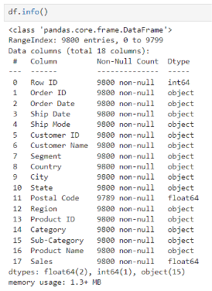
DATASET OVERVIEW
Data Exploration
Features Analyzed
9800 Transactions
18 business attributes
4 years of sales history
Multiple regions, categories, and customer segments
Target Variable (Sales)
793 Customers
1994 Products
4 Regions
49 States
Customer
Product
Region
State
City
Category
Segment
Sales
Order Date
The dataset provides sufficient customer, product, geographic, and sales information to perform comprehensive business performance analysis.

Slide 4
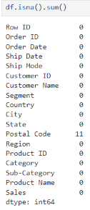
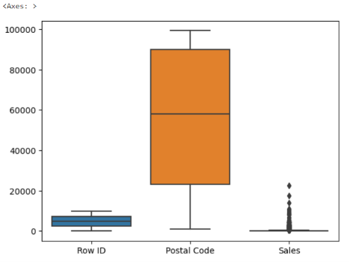
Data Quality Assessment
DATA CLEANING
Missing values were identified in the Postal Code field.
All missing records belonged to Burlington, Vermont.
Since Postal Code is a geographical identifier rather than a measurable numerical feature, location-based imputation was more appropriate than mean or median replacement.
Duplicate records checked.
Data validated for analysis.
OUTLIER HANDLING
Numerical columns contained outliers that could influence analysis results.
IQR Method used for outlier detection.
Outliers were identified using the IQR method and evaluated before treatment to reduce the influence of extreme values on analysis.
Handling outliers reduced the impact of extreme values and improved the reliability of statistical analysis.

Slide 5
Key Questions Driving the Analysis
1. Is the business growing over time?
2. Which region contributes the highest revenue?
3. Which category generates maximum sales?
4. Which customer segment drives sales?
5. Which products are top performers?
6. Which customers contribute most to revenue?
7. Which states and cities perform best?
8. What business actions can improve performance?
Category A

Slide 6
Exploratory Data Analysis
ANALYSIS PERFORMED
• Sales Distribution Analysis
• Customer Analysis
• Product Analysis
• Category Analysis
• Segment Analysis
• Regional Analysis
• State & City Analysis
• Year-wise Sales Trend Analysis
The business generated over $2.26M in revenue from 10K orders
The customer base consists of 793 unique customers purchasing from nearly 2,000 products.
The average sales per order is around $231, indicating a healthy transaction value.

Slide 7
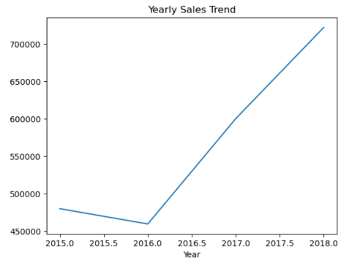
Sales show a strong upward trend across the years.
The business has experienced sustainable growth, indicating increasing customer demand and effective sales performance.
Analyze growth drivers from 2017 and 2018 and replicate successful strategies to sustain long-term growth.
Expected Impact:
Sustained revenue growth and improved forecasting of future sales performance.
2015 → $479.9K
2016 → $459.4K
2017 → $600.2K
2018 → $722.1K
SALES GROWTH ANALYSIS

Slide 8
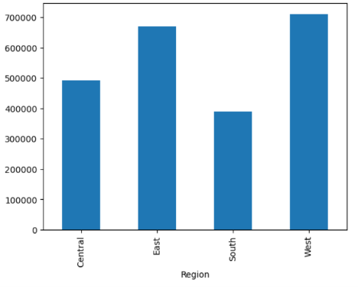
REGIONAL PERFORMANCE
Sales performance varies significantly across regions.
The West Region is the strongest revenue contributor, while the South Region lags behind, indicating uneven market performance.
West → $710K
East → $670K
Central → $493K
South → $389K
Adopt successful sales and marketing practices from the West Region and implement them in lower-performing regions.
Expected Impact:
Improved regional balance and increased revenue contribution from underperforming markets.

Slide 9
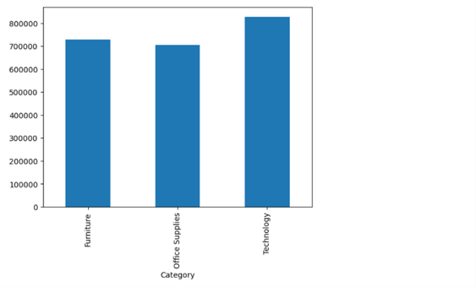
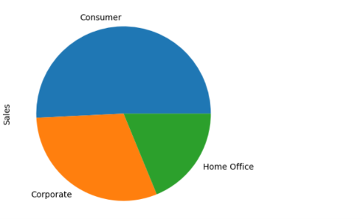
Category & Segment Analysis
Category
Segment
Technology outperforms other categories.
Consumer segment generates the majority of sales.
Technology products are primary revenue drivers.
Consumer customers represent the core customer base.
Technology → $827K
Furniture → $729K
Office Supplies → $705K
Consumer → $1.15M
Corporate → $688K
Home Office → $425K
Increase investment in Technology inventory and promotions.
Expected Impact: Higher revenue generation by focusing on the strongest-performing product category.
Focus retention and loyalty initiatives on Consumer customers.
Expected Impact: Improved customer retention and increased customer lifetime value.

Slide 10
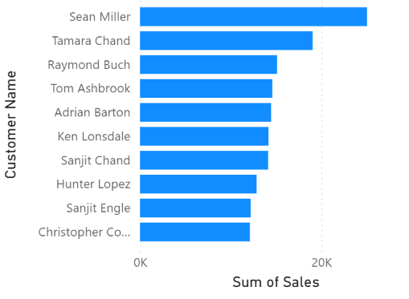
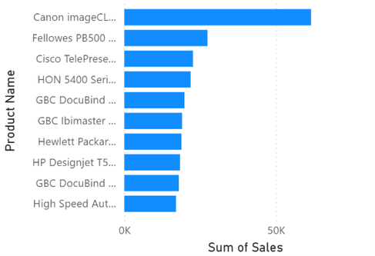
Customer & Product Analysis
Revenue is concentrated among a small group of customers and products.
High-value customers and products contribute disproportionately to overall sales.
Implement customer loyalty initiatives and focus on promoting top-performing products.
Expected Impact:
Reduced customer churn and increased sales from high-value customers and products.

Slide 11

Geographic Analysis
California → $446K
New York → $306K
Texas → $169K
Washington → $135K
Sales are concentrated in a few high-performing states.
California and New York together contribute a substantial share of total revenue, indicating strong regional dependence.
Continue investing in high-performing markets while identifying growth opportunities in underrepresented states.
Expected Impact:
Geographic expansion with reduced dependence on a small number of states.

Slide 12
Executive Summary
• Sales increased by 50% from 2015 to 2018.
• West Region generated the highest revenue ($710K).
• Technology emerged as the top-performing category ($827K).
• Consumer customers contributed the majority of sales ($1.15M).
• California and New York were the strongest-performing states.
• Revenue concentration exists among a small group of customers and products.
Overall Finding:
Technology products, Consumer customers, and the West Region emerged as the primary revenue drivers of the business.

Slide 13
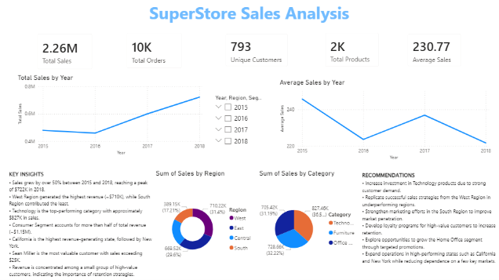
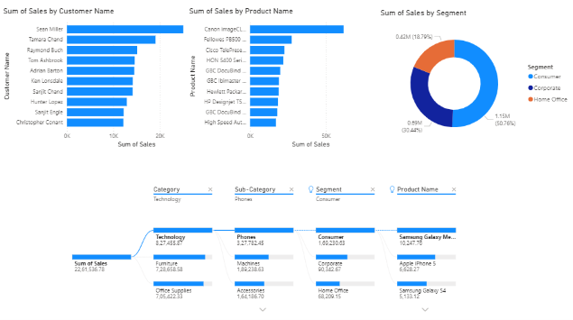
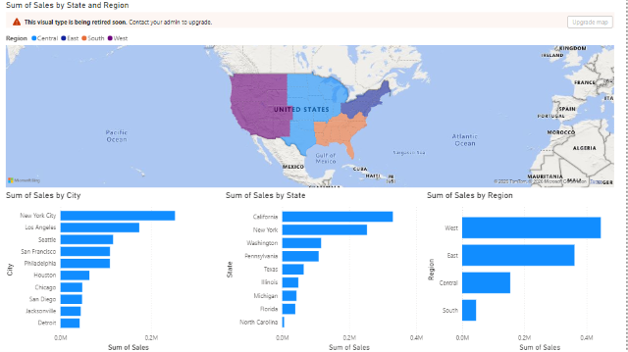
Features
✓ KPI Monitoring
✓ Interactive Filters
✓ Decomposition Tree
✓ Drill-through Analysis
✓ Business Insights Panel
Power BI Dashboard
Business Value
• Enables faster decision-making
• Provides self-service analytics
• Improves performance monitoring
• Supports data-driven business strategies

Slide 14
Executive Recommendations
1. Expand Technology product offerings.
2. Improve customer retention strategies.
3. Replicate successful West Region sales practices.
4. Increase focus on Home Office customers.
5. Strengthen underperforming regions.
6. Use dashboard insights for continuous decision-making.

Slide 15
Conclusion
This project transformed 9,800 transactional records into actionable business intelligence.
The analysis identified key growth drivers, revenue opportunities, customer behavior patterns, and strategic recommendations.
The resulting Power BI dashboard enables stakeholders to monitor performance and make data-driven decisions effectively.

Slide 16
THANK YOU!
I welcome your feedback and questions!

